Slide 1

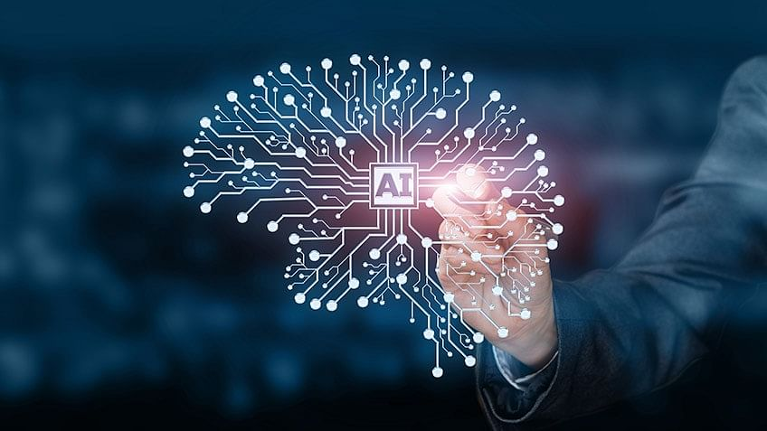
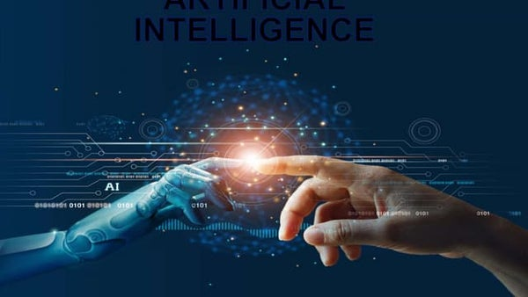
The Power of AI: Revolutionizing Industries and Shaping the Future Mihiretu Jackson Virginia State University, Petersburg, VA 23806
Abstract
Artificial Intelligence (AI) has become an increasingly important part of our lives, shaping the way we live and work. In this poster presentation, we explore the various ways in which AI is being used across industries such as healthcare, finance, and transportation. We examine key concepts of AI, including machine learning and neural networks, and discuss their applications in real-world scenarios. We also consider the future of AI and the potential ethical considerations that need to be addressed. Overall, this poster presentation aims to provide a comprehensive overview of AI and its impact on society, highlighting the numerous opportunities and challenges it presents.
Introduction
AI is a rapidly growing field with numerous applications in various industries.
AI is a form of technology that allows machines to simulate intelligent behavior and decision-making.
AI has the potential to significantly increase productivity, efficiency, and innovation.
However, the development and use of AI also raise ethical considerations, such as privacy, bias, and job. displacement
What is AI
AI is a form of technology that allows machines to simulate intelligent behavior and decision-making.
There are several key concepts and techniques that are commonly used in AI, including:
Machine learning: This is a type of AI that involves training machines to learn from data and improve their performance over time..
Deep learning: This is a subfield of machine learning that involves training neural networks to perform complex tasks, such as image recognition and natural language processing.
Neural networks: These are computer systems that are modeled on the structure and function of the human brain.
AI has numerous applications across various industries, including healthcare, finance, transportation, and many others.
Overall, the objective of this presentation is to raise awareness and encourage discussion about the rapidly evolving field of AI and its impact on the world we live in.
Applications of AI
AI in Healthcare
AI is transforming the healthcare industry by helping doctors diagnose diseases, analyze medical images, and develop personalized treatment plans.
AI in Finance
AI is being used in finance to detect fraud, automate customer service, and make investment decisions.
AI in Transportation
AI is revolutionizing the way we travel, from self-driving cars to air traffic control.
The Future of AI
In this final section, we will look to the future and explore the potential impact of AI on society. We will discuss ethical considerations around AI, such as job displacement and privacy concerns. We will also look at the many opportunities presented by AI, such as increased productivity and new innovations.
Literature Cited
Hopkins, D.L., Gilbert, K.D., Saunders, K.L., 1990. The performance of short scrotum and wether lambs born in winter or spring and run at pasture in northern Tasmania. Aust. J. Exp. Agric. 30:165‐170
O’Brien, D., Wildeus, S., Schoenian, S., Semler, J., David, G., Bennet, M.B., Anderson, C., Travis, A. 2019. 194 Libido and semen quality in intact and altered (short scrotum and castrated) post-pubertal male dairy sheep lambs. J Anim Sci 97:76
Probert, A.D., Davies, A.S., 1986. A study of short scrotum, castrated and entire ram lambs. N. Z. Soc. Anim. Prod. 46:55‐58
Tiernay, L.A., Hallford, D.M., 1985. Mating behavior, serum testosterone and semen characteristics in vasectomized and short scrotum rams. Theriogenology 23:535-545
Conclusion
AI is a powerful technology that is transforming industries across the globe. As we look to the future, it is clear that AI will continue to shape the world we live in. Whether it is in healthcare, finance, transportation, or beyond, AI has the potential to improve our lives in countless ways. However, it is important to address the ethical considerations that come with its use to ensure that AI is developed and used in a responsible and beneficial way.
Notes:
Machine learning: This is a type of AI that involves training machines to learn from data and improve their performance over time. Machine learning algorithms can be divided into three main categories: supervised learning, unsupervised learning, and reinforcement learning.
Deep learning: This is a subfield of machine learning that involves training neural networks to perform complex tasks, such as image recognition and natural language processing. Deep learning has led to significant advances in fields such as computer vision and speech recognition.
Neural networks: These are computer systems that are modeled on the structure and function of the human brain. Neural networks can be used for a variety of tasks, including pattern recognition, decision-making, and prediction.
AI in Healthcare
AI is transforming the healthcare industry by helping doctors diagnose diseases, analyze medical images, and develop personalized treatment plans. In this section, we will explore some of the most exciting developments in AI healthcare, such as virtual nurses, telemedicine, and wearable technology.
AI in Finance
AI is being used in finance to detect fraud, automate customer service, and make investment decisions. In this section, we will explore some of the most promising applications of AI in finance, including robo-advisors, chatbots, and algorithmic trading.
AI in Transportation
AI is revolutionizing the way we travel, from self-driving cars to air traffic control. In this section, we will explore some of the most exciting developments in AI transportation, including autonomous vehicles, smart traffic management systems, and drone deliveries

